Slide 1
The trans-pacific partnership: overview
Cielito F. Habito
March 17, 2016

Slide 2
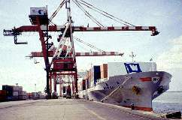
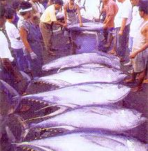
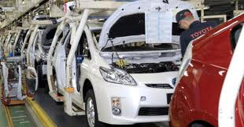
TRADE PROJECT
TRADE aims to help improve the Philippines’standing in the global economy through higher levels of trade and foreign direct investment.

Slide 3
TRADE PROJECT COMPONENTS
Component 1 Trade & Investment Policy
Component 2 Trade Facilitation
Component 3 Competition Policy
Component 4 Public Outreach & Advocacy

Slide 4
Trans-Pacific Partnership (tpp)
A “21st century agreement” – “high-standard, ambitious, comprehensive, and balanced”
TPP Agreement signed on February 4, 2016
Currently with 12 participating countries on both sides of the Pacific having:
Combined population of 800 million
GDP of $28 trillion (40% of global GDP)
$9 trillion in merchandise trade; $2 trillion trade of services (30% of world trade)

Slide 5
TPP: Who are in it?
Australia (2008)
Brunei (2005)
Chile (2005)
Canada (2012)
Japan (2013)
Malaysia (2010)
Mexico (2012)
New Zealand (2005)
Peru (2008)
Singapore (2005)
United States (2008)
Viet Nam (2008)

Slide 6
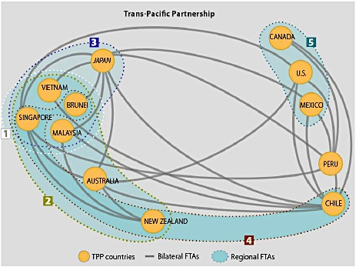
Current TPP members are already part of existing Asia-Pacific FTAs

Slide 7
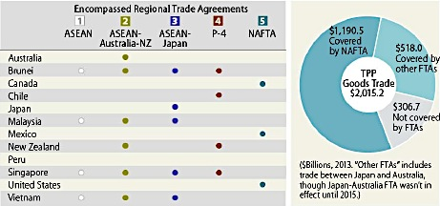
TPP and existing ftas

Slide 8
TPP: Who are interested to join?
South Korea
Philippines
Taiwan
Thailand
Colombia
Indonesia
India
Sri Lanka

Slide 9
TPP: what are its key features?
Comprehensive Market Access
Eliminate/reduce tariff and non-tariff barriers to substantially all trade in goods & services and investment to create new opportunities for workers and businesses, and immediate benefits for consumers.

Slide 10
TPP: what are its key features?
Foster cross-border value chains
Facilitate the development of production networks and supply chains and promote seamless trade to create jobs, raise the standard of living; facilitate cross-border integration.

Slide 11
TPP: what are its key features?
Addressing new trade challenges
Promote innovation, productivity and competitiveness by addressing new issues such as the digital economy and the role of SOEs in the global economy.

Slide 12
TPP: what are its key features?
Inclusive trade
Ensure that parties regardless of level of development are able to participate, and that businesses of all sizes (especially SMEs) can seize its opportunities and take full advantage of its benefits.

Slide 13
TPP agreement: scope
30 Chapters; includes Schedules and Annexes.
Country-specific exceptions in Annexes (e.g., SOEs).
New and emerging trade issues & cross-cutting issues, e.g. Internet/digital economy, SOEs, SMEs.
Close cooperation, capacity-building for the lesser developed TPP countries; special transitional periods and mechanisms to give some countries additional time, when needed, to develop capacity to implement new obligations.

Slide 14
Chapters of The tpp agreement
Initial Provisions & Gen Definitions
Nat’l Treatment & Market Access
Rules of Origin
Textiles & Apparel
Customs Adm & Trade Facilitation
Trade Remedies
SPS Measures
Technical Barriers to Trade
Investment
Cross-Border Trade in Services
Financial Services
Temporary Entry of Business Persons
Telecommunications
Electronic Commerce
Government Procurement
Competition Policy
State-Owned Enterprises (SOEs)
Intellectual Property
Labour
Environment
Cooperating & Capacity Building
Competition & Business Facilitation
Development
Small- & Medium-Sized Enterprises
Regulatory Coherence
Transparency & Anti-Corruption
Administrative & Institutional Provisions
Dispute Settlement
Exceptions
Final Provisions

Slide 15
The philippines & tpp
Existing FTAs with 7 TPP members
Australia – AANZFTA
Brunei – AFTA, AANZFTA, ACFTA, AJCEP, AIFTA, AKFTA
Japan – PJEPA, AJCEP
Malaysia – AFTA, AANZFTA, ACFTA, AJCEP, AIFTA, AKFTA
New Zealand – AANZFTA
Singapore – AFTA, AANZFTA, ACFTA, AJCEP, AIFTA, AKFTA
Viet Nam – AFTA, AANZFTA, ACFTA, AJCEP, AIFTA, AKFTA

Slide 16
The philippines & tpp
Philippines has no existing FTAs with 5 TPP members:
Canada
Chile
Mexico
Peru
United States (has GSP access)

Slide 17
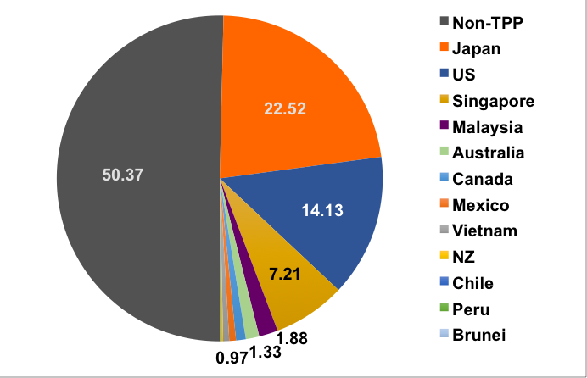
TPP COUNTRIES’ SHARE IN TOTAL PH EXPORTS, 2014

Slide 18
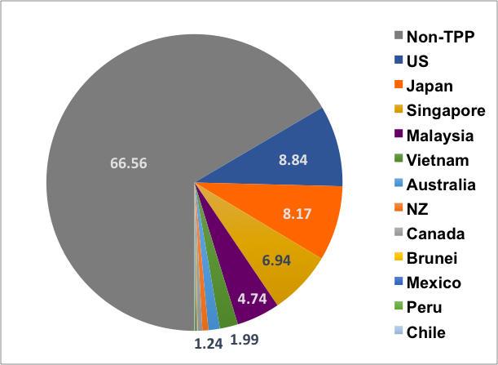
TPP COUNTRIES’ SHARE IN TOTAL PH IMPORTS, 2014

Slide 19
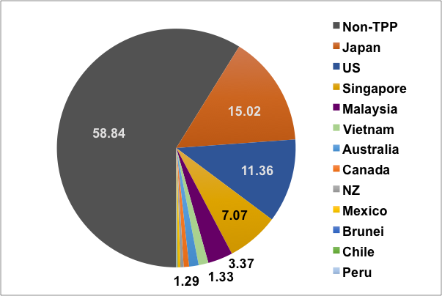
TPP COUNTRIES’ SHARE IN TOTAL PH TRADE, 2014

Slide 20
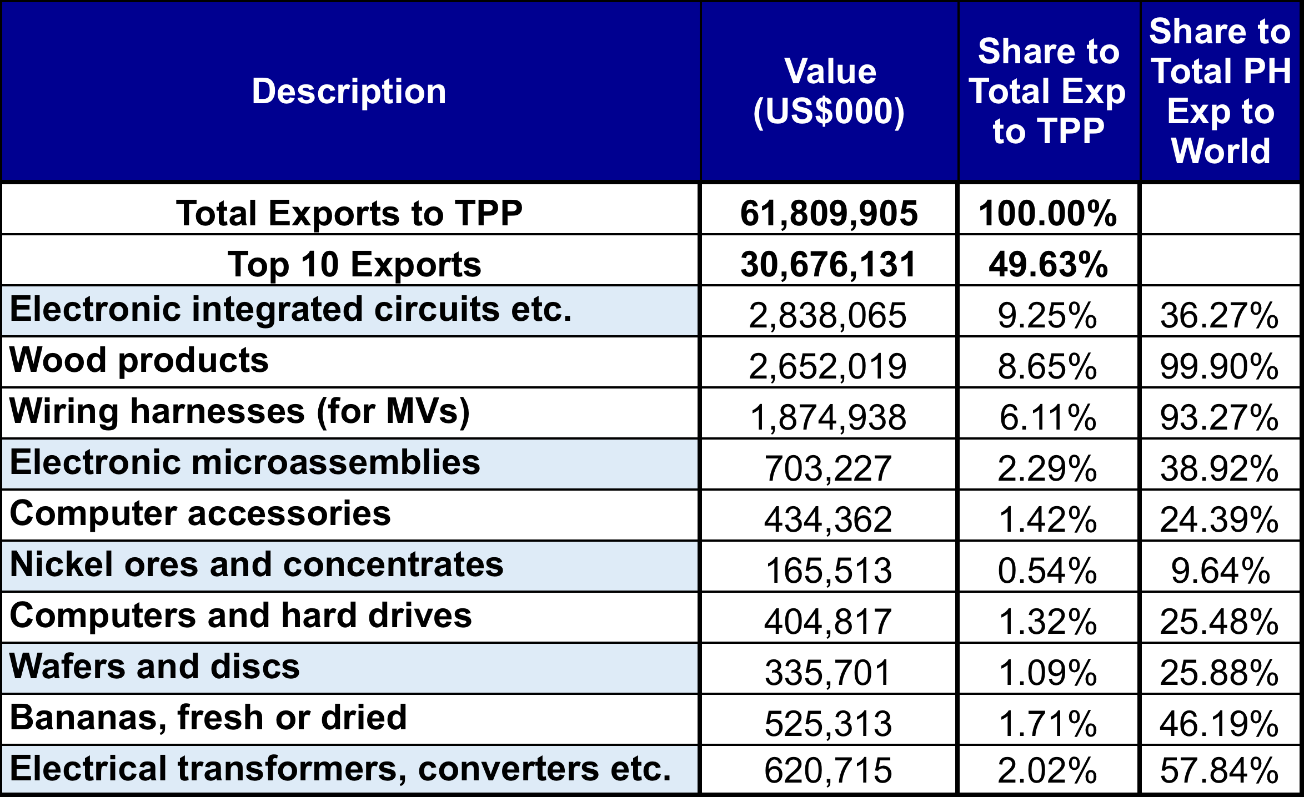
PH Exports to TPP COUNTRIES, 2014

Slide 21
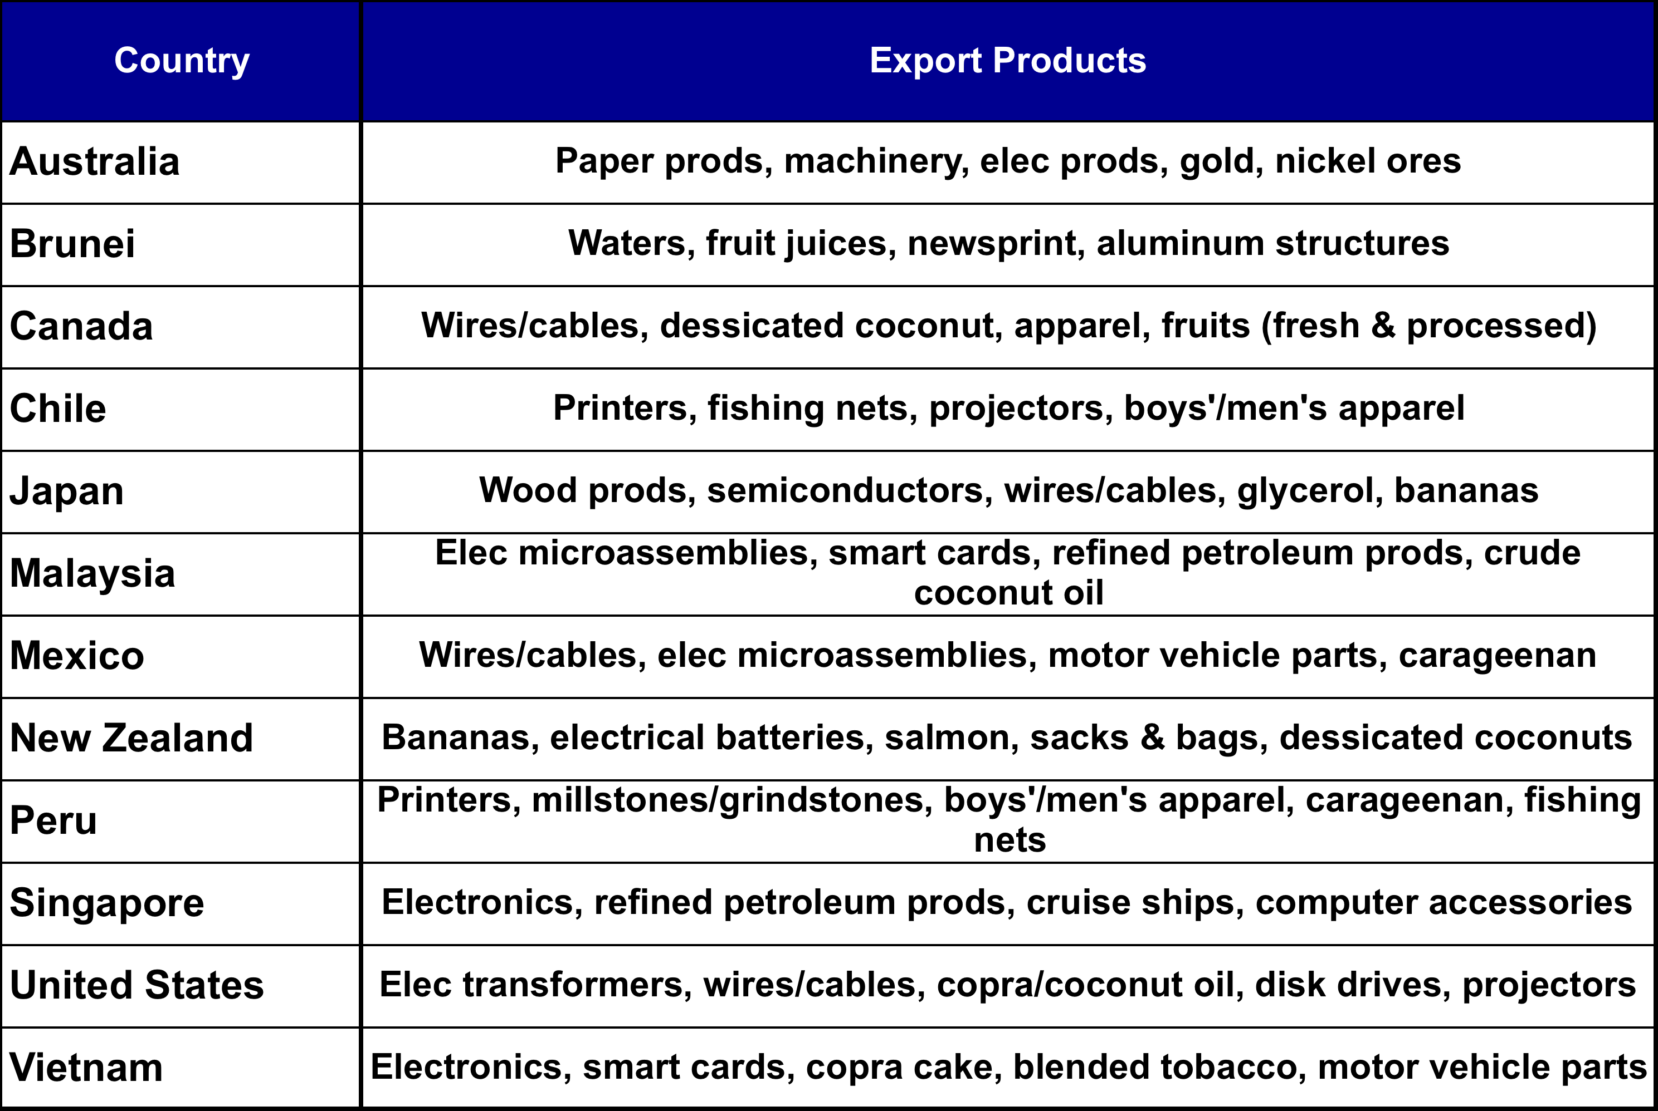
TOP PH EXPORTS TO TPP COUNTRIES

Slide 22
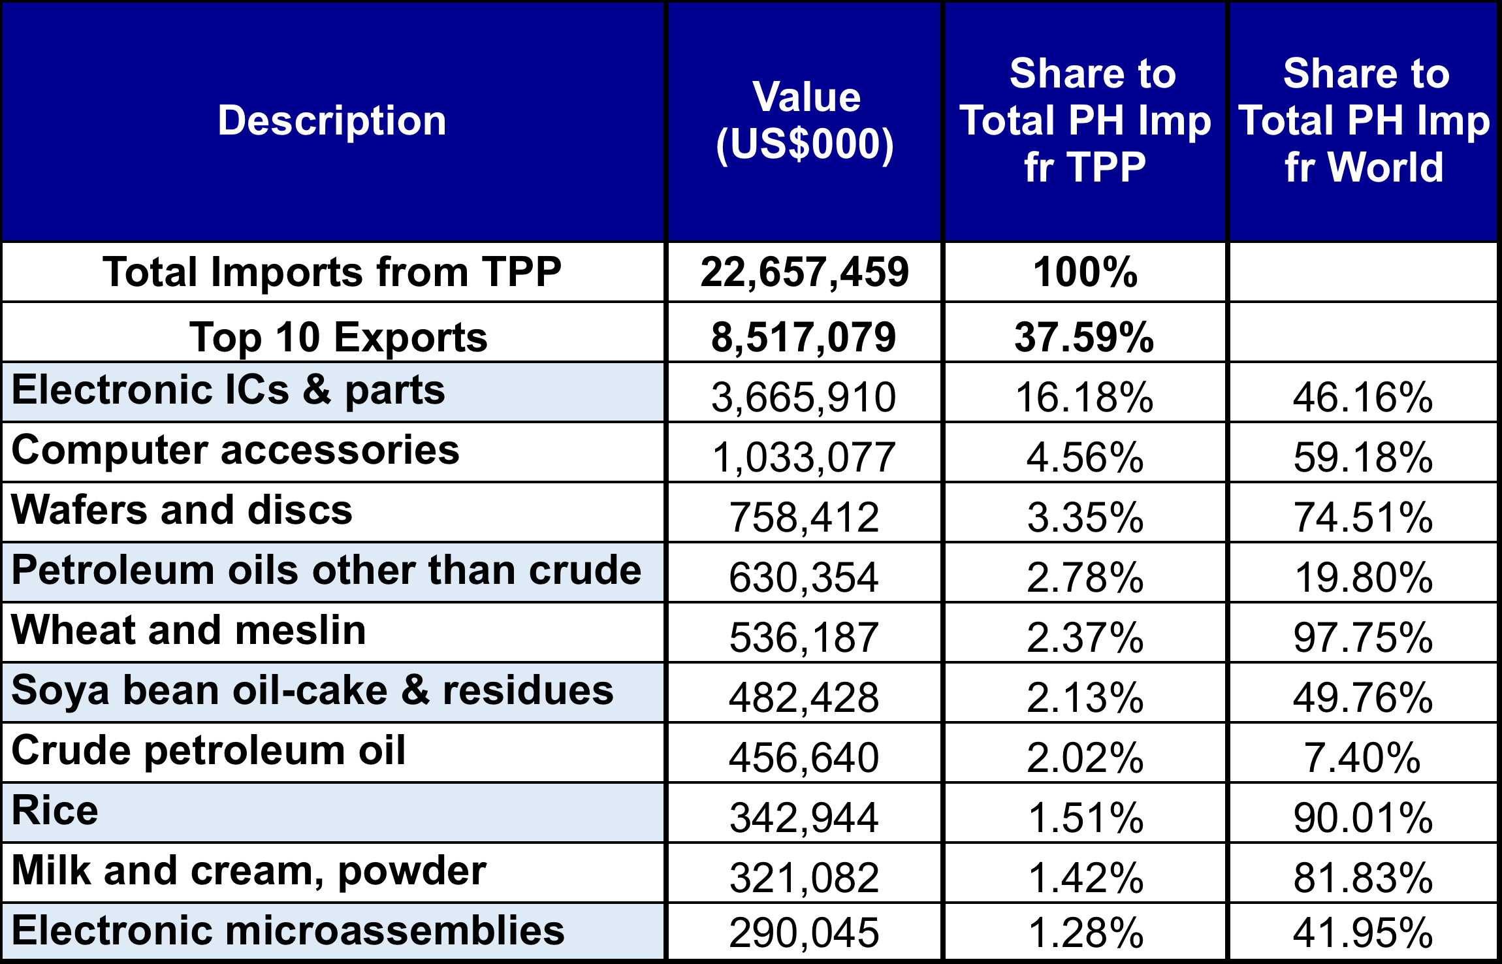
PH Imports from tpp countries, 2014

Slide 23
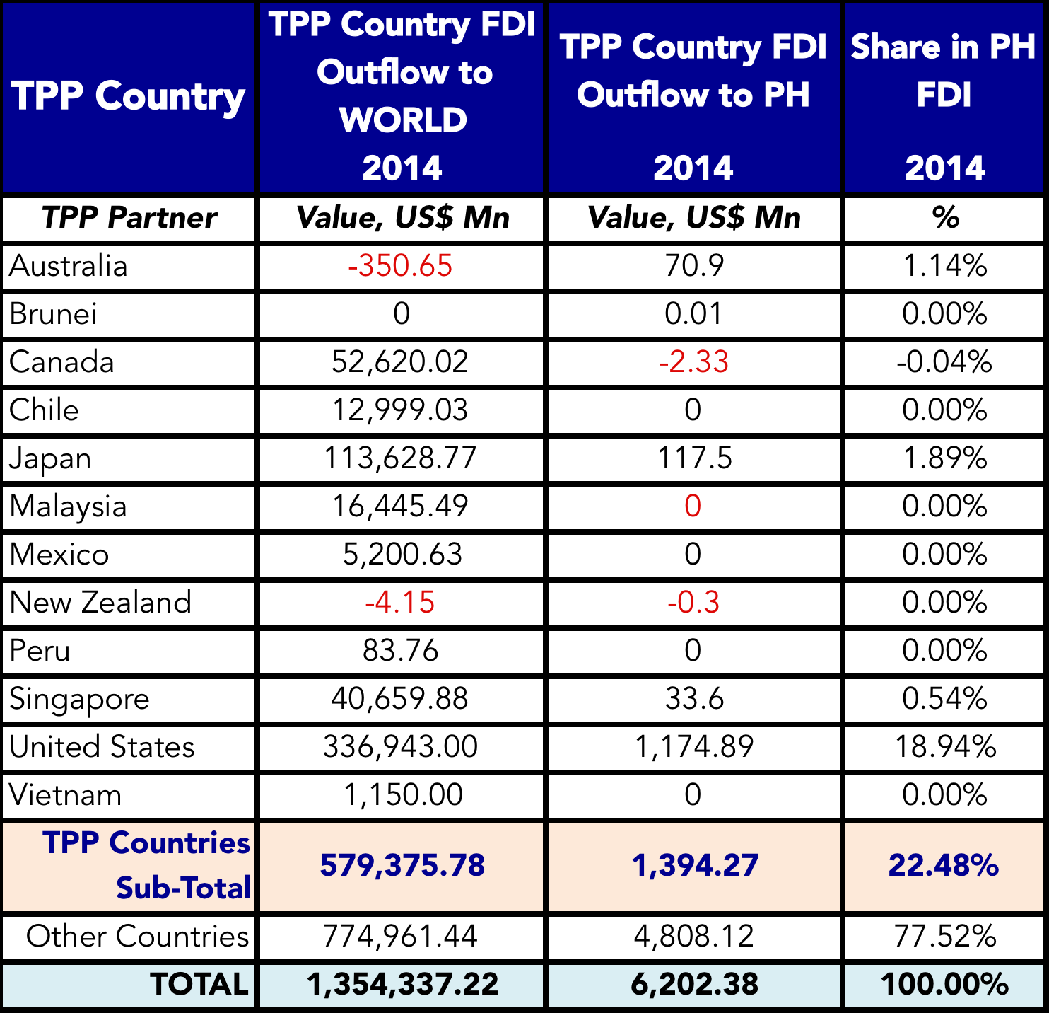
TPP FDI FLOWS TO PHILIPPINES, 2014

Slide 24
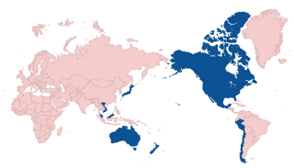
THE PhilippineS & TPP
Clarete (UPSE) Study (2014):
Increase exports by up to 42%
Raise GDP by up to 59%.
Cororaton (Virginia Tech) Study (2014) :
Non-membership will divert substantial trade away from PH to TPP members.
Vulnerable industries: Textile & wearing apparel, petroleum products, construction, services, equipment manufactures.
Membership will increase exports by $300 million in 2015, rising to $3 billion by 2024.

Slide 25
THE PhilippineS & TPP
How ready is PH for TPP?
What policy gaps remain?
What laws are inconsistent with TPP requirements?
How should PH deal with these?

Slide 26
Thank
You

