Slide 1

Economic Outlook
December 2014
Economic Policy Division

Slide 2
U.S. GDP Actual and Potential
Quarterly, Q1 1980 to Q4 2015
Real GDP Trillion 2009 Dollars Log Scale
$18.0
Forecast
$15.0
$12.5
$9.0
$6.5

Slide 3
U.S. GDP per Capita: Actual and Potential
Quarterly, Q1 1980 to Q3 2014
2009 Dollars

Slide 4
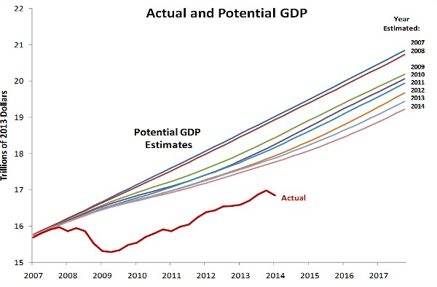
U.S. GDP: Estimates of Potential
Quarterly, Q1 1980 to Q4 2017

Slide 5
Comparing Recessions
Trough | GDP Loss (Peak to Trough) | Duration of Recession | GDP Growth in the following year | GDP Growth in the following 3 years | Months from end of recession until we reached prior employment peak | Months from end of recession until GDP reached potential
May 1954 (II) | -2.5 (%) | 10 (months) | 7.9 (%) | 4.0 | 13 | 2
April 1958 (II) | -3.1 | 8 | 9.6 | 4.2 | 12 | 4
February 1961 (I) | -0.5 | 10 | 7.5 | 5.8 | 10 | 10
November 1970 (IV) | -0.2 | 11 | 4.5 | 5.2 | 6 | 5
March 1975 (I) | -3.2 | 16 | 6.2 | 4.5 | 9 | 13
November 1982 (IV) | -2.6 | 16 | 7.7 | 5.8 | 12 | 20
March 1991(I) | -1.4 | 8 | 2.6 | 3.2 | 23 | 25
November 2001 (IV) | +0.7 | 8 | 1.9 | 2.9 | 39 | 13
June 2009 (II) | -4.7 | 18 | 2.5 | 2.2 | 59 | NA

Slide 6
Real GDP Outlook

Slide 7
Personal Consumption Outlook
Real Personal Consumption Expenditures

Slide 8
Real Disposable Personal Income

Slide 9
Household Net Worth
Household Wealth

Slide 10
Household Net Worth
Household Wealth

Slide 11
Household Balance Sheet
Household Assets
Household Liabilities

Slide 12
Consumer Debt Service

Slide 13
Domestic Bank Lending

Slide 14
Consumer Confidence

Slide 15
Auto & Light Truck Sales

Slide 16
Housing Market Trends
Home Sales
Housing Starts
Median Home Prices
Housing Affordability Index

Slide 17
Housing Market Trends
Housing Inventory
Mortgage Delinquency and Foreclosure Rates

Slide 18
Real Business Fixed Investment

Slide 19
Investment Drivers
Industrial Production
Capacity Utilization

Slide 20
Sector Indicators
ATA Truck Tonnage Index
Boxboard Production
Monthly Leasing and Finance Index
Total Rail Carloadings

Slide 21
Domestic Bank Lending

Slide 22
Business Confidence
ISM Manufacturing Index

Slide 23
Oil

Slide 24
Natural Gas

Slide 25
Labor Market
Total Nonfarm Jobs
Household Employment
Unemployment Rate November 5.8%
Initial Unemployment Claims

Slide 26
Labor Market
Part-time for Economic Reasons
Discouraged Workers
Duration of Unemployment
Civilian Participation Rate

Slide 27
Employment-Population Ratio
Percent

Slide 28
Labor Market

Slide 29
Labor Market

Slide 30
Interest Rate Spreads
Yield Spread
10-Year Treasury – 3 month Treasury
Risk Spread
Moody's Seasoned Baa Corporate Bond Yield Minus Moody's Seasoned Aaa Corporate Bond Yield
TED Spread
3-Month LIBOR Minus 3-Month Treasury

Slide 31
Fed Policy
Bank Assets and Liabilities

Slide 32
U.S. Trade
Real Net Exports of Goods and Services
U.S. Nominal Trade Weighted Exchange Rate

Slide 33
Eurozone Growth and Jobs
Source: Oxford Economics

Slide 34
Eurozone Monetary Policy
Source: Oxford Economics

Slide 35
European Growth
Source: Oxford Economics

Slide 36
United Kingdom Growth and Jobs
Source: Oxford Economics

Slide 37
Emerging Markets
Real GDP
Source: Oxford Economics

Slide 38
CBO’s Baseline Deficit
(August 2014)
Budget Deficit
Deficit to GDP

Slide 39
Government Baseline Outside Debt
(CBO’s Baseline – August 2014)
Debt
Debt to GDP

Slide 40
Government Gross Debt
(CBO’s Baseline – August 2014)
Gross Debt
Gross Debt to GDP

Slide 41
Government Revenues and Outlays
( percent of GDP)
Source: CBO Baseline (August 2014)

Slide 42
Government Outlays
Discretionary Entitlements Net Interest

Slide 43
Mandatory Spending
Social Security Medicare Medicaid Income Security Other Spending
Social Security Medicare Medicaid Income Security Other Spending

Slide 44
FY 2013 Revenues and Outlays
Outlays
Source: CBO
Mandatory (entitlements and net interest)
Discretionary

Slide 45
FY 2024 Revenues and Outlays
Outlays
Source: CBO
Mandatory (entitlements and net interest)
Discretionary

Slide 46
Government Revenues by Source
Individual Income Tax Social Insurance Taxes Corporate Income Tax Other Taxes

